Slide 1
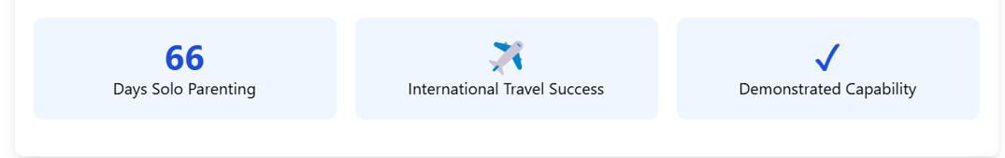





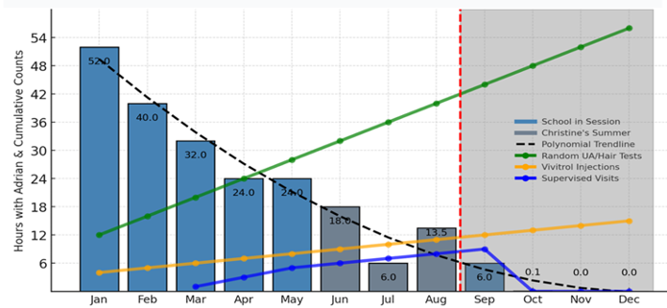



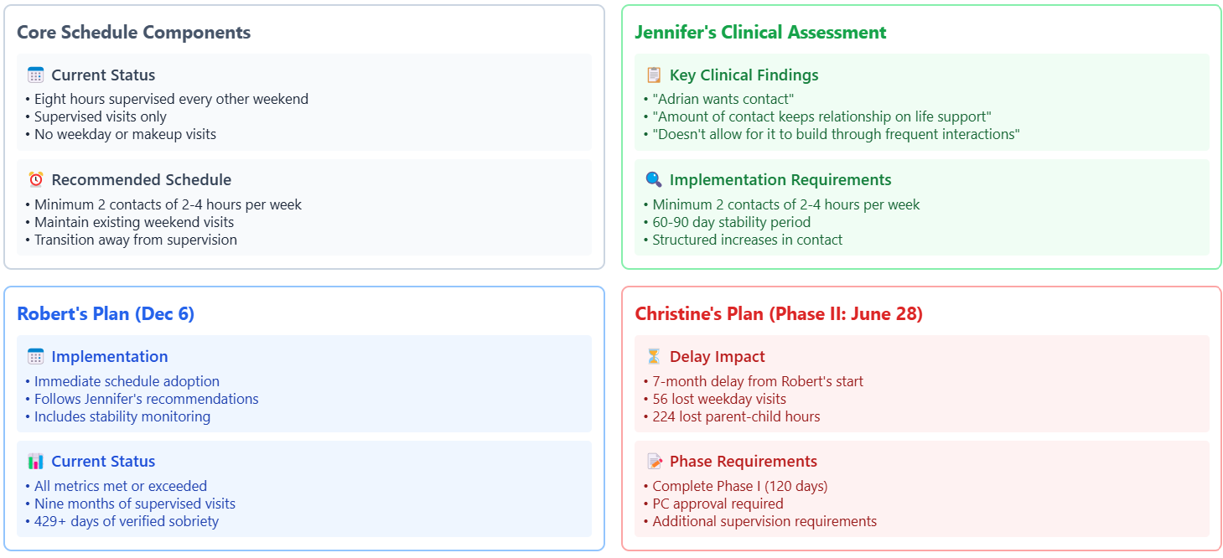
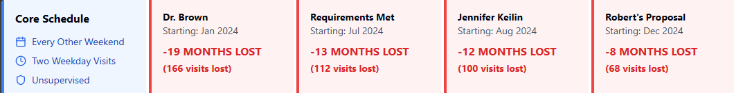
Proven Progress, Ignored Results: Rebuilding Relationships Through Recognition
Primary Caregiver 2023
Solo Parenting Days
Demonstrated Capability
Father-Son Bonds
International Travel
Sobriety Verification
420 → Consecutive days of verified sobriety
Supervised Visits
09 → Months of positive supervised visits
Verification vs Visitation 2024
Verification and supervision were intended to rebuild relationships but instead resulted in only .05% time with AD, practically erasing the parent-child bond. Max has been entirely excluded.
TBD
TBD
Conical Scenario
8
Max and Adrian’s Losses

Slide 2
Rationalizing Plans: A Collaborative Framework for Stability and Progress
Christine and I share common ground: we both want Max and Adrian to thrive emotionally, physically, and psychologically. We agree the current status quo is unhealthy, and a phased plan, supported by verification and professional input, is the best way to foster their well-being and relationships with both of us.
Verified Progress → The progress made demonstrates that the framework of monitoring and professional oversight can work effectively:
Sobriety → 420+ days verified with 3x daily SoberLink, ETG testing, and Vivitrol compliance.
Safety → Nine months of positive supervised visits demonstrating parental capability.
Treatment → Active DV program participation with documented progress.
Parenting → In 2023, I was the primary caregiver for 66 days of successful solo parenting, including international travel, caring for Christine's extended family, and sharing the closest father-son bonds we've experienced.
Professional Support → Multiple therapeutic recommendations for increased time and reunification – from Dr. Brown's 50/50 custody plan in Dec. 2023 to Jennifer Keilin's endorsement of unsupervised visits in Aug 2024.
Professional Assessment → Christine and I both prioritize the safety of Max and Adrian. I respect that Christine's concerns stem from our shared history, but decision makers must weigh my verified progress against past fears. The evidence is compelling: consistently positive supervised visits, verified sobriety, and strong therapeutic engagement.
As reunification counselor Jennifer Keilin observed, "limited contact keeps their relationship on life support," emphasizing that delays only weaken father-son bonds. Keilin strongly recommended increasing time with an additional minimum of two visits weekly (2–4 hours each) with unsupervised visits within 60–90 days- in August. Positive affirmations are echoed by Debbie Bayer, who noted Christine’s acknowledgment that "he’s a good dad" when sober, and by other professionals who have consistently expressed confidence in my parenting capacity
Risk Assessment → Extended supervision at this point not only fails to protect Max and Adrian, but it also reinforces outdated perceptions of risk. Continued monitoring implies to the children that danger exists, when all objective evidence indicates otherwise. Artificial separation prevents them from forming authentic relationships with me and risks permanent alienation.
While Christine's past concerns are understandable, delays undermine the trust we've worked to rebuild and create lasting harm to the children. Professionals repeatedly confirm reunification is critical to their emotional well-being.
Logical Framework → These measures have proven their effectiveness. Restarting or duplicating these steps is unnecessary and harmful:
If these measures protect Max and Adrian → they've been protected since compliance began.
If monitoring proves sobriety → 420 days of compliance has confirmed safety for the children.
If supervision ensures safety → nine months of positive reports have confirmed safe parenting.
If the class enrollment works → voluntary participation already demonstrates my commitment.
If recent history matters → we need to acknowledge the success of 2023 without mischaracterization.
If the parenting plan's measures are valid → they must remain valid yesterday, today, and tomorrow.
Impact Analysis → Every additional delay in reunification creates real and tangible costs for Max and Adrian:
Pointless Repetition → Restarting the same program that created this harmful status quo – one that even Christine acknowledges must change – serves no purpose other than punitive delay.
Development Impact → These formative years shape lifelong bonds and personalities. Every restricted day means irreplaceable father-son moments and lost opportunities for authentic connection.
Emotional Harm → Artificial separation reinforces false fears and prevents natural healing of father-son bonds. Supervised visits suggest danger where none exists.
Wasted Resources → $1,000 per supervised day drains resources that could be better spent on therapy, education, or enrichment activities for Max and Adrian.
Final Emphasis: For Max and Adrian → The evidence is clear – every required protection has been met and verified. Yet applying these same measures resulted in reducing Adrian's time to .05% custody. Let’s not ask to restart identical requirements, and hope for different results. This isn't about verification – it's about recognizing success when it's achieved. Each supervised visit, each artificial restriction, and each delayed reunion inflicts damage we can prevent today.
This is not about Christine's control or my compliance. It's about two young men whose healthy development depends on ending this manufactured crisis. We have the power to stop harming them right now. The only question is: will we?
The path forward is clear, and the protection is proven. Further delay serves no one but hurts everyone. Max and Adrian need us to act today – their childhood won't wait for personal agendas to play out.

